Slide 1
Support Vector Machines
Chapter 18.9 and the paper “Support vector machines” by M. Hearst, ed., 1998
Acknowledgments: These slides combine and modify ones provided by Andrew Moore (CMU), Carla Gomes (Cornell), Mingyue Tan (UBC), Jerry Zhu (Wisconsin), Glenn Fung (Wisconsin), and Olvi Mangasarian (Wisconsin)

Slide 2
What are Support Vector Machines (SVMs) Used For?
Classification
Regression and data-fitting
Supervised and unsupervised learning

Slide 3
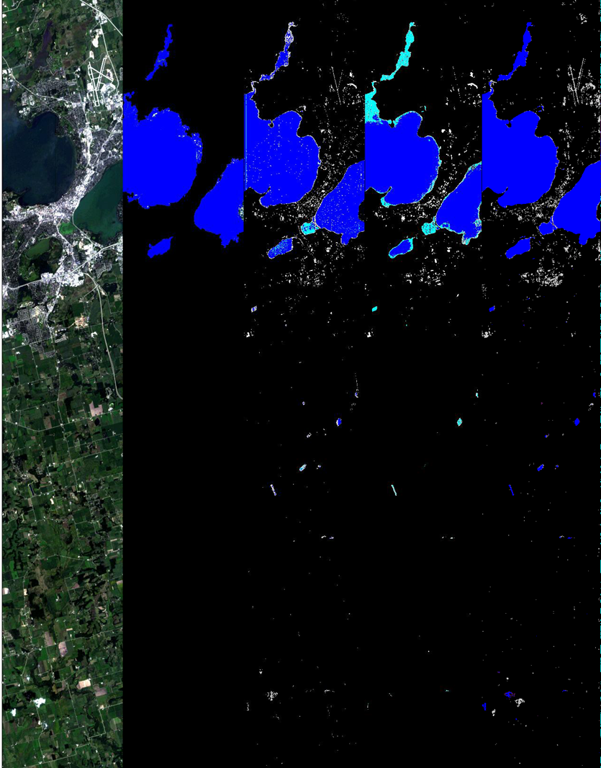
Lake Mendota, Madison, WI
Identify areas of land cover (land, ice, water, snow) in a scene
Two methods:
Scientist manually-derived
Support Vector Machine (SVM)
Lake Mendota, Wisconsin
Classifier | Expert Derived | SVM
cloud | 45.7% | 58.5%
ice | 60.1% | 80.4%
land | 93.6% | 94.0%
snow | 63.5% | 71.6%
water | 84.2% | 89.1%
unclassified | 45.7%
Visible Image
Expert Labeled
Expert Derived
Automated Ratio
SVM
Courtesy of Steve Chien of NASA/JPL

Slide 4
Linear Classifiers
x
f
y
denotes +1
denotes -1
How would you classify this data?

Slide 5
Linear Classifiers (aka Linear Discriminant Functions)
Definition:
A function that is a linear combination of the components of the input (column vector) x:
where w is the weight (column vector) and b is the bias
A 2-class classifier then uses the rule:
Decide class c₁ if f(x) ≥ 0 and class c₂ if f(x) < 0
or, equivalently, decide c₁ if w^{T}x ≥ -b and c₂ otherwise

Slide 6
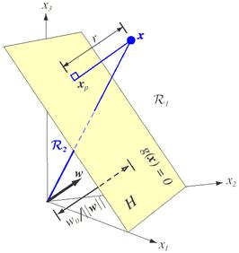
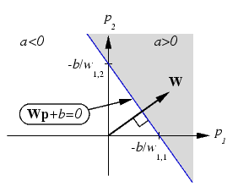
w is the plane’s normal vector
b is the distance from the origin
Planar decision surface in d dimensions is parameterized by (w, b)

Slide 7
Linear Classifiers
x
f
y
f(x, w, b) = sign(w^{T} x + b)
denotes +1
denotes -1
How would you classify this data?

Slide 8
Linear Classifiers
x
f
y
f(x, w, b) = sign(w^{T} x + b)
denotes +1
denotes -1
How would you classify this data?

Slide 9
Linear Classifiers
x
f
y
f(x, w, b) = sign(w^{T} x + b)
denotes +1
denotes -1
How would you classify this data?

Slide 10
Linear Classifiers
x
f
y
f(x, w, b) = sign(w^{T} x + b)
denotes +1
denotes -1
Any of these would be fine …
… but which is best?

Slide 11
Classifier Margin
x
f
y
f(x, w, b) = sign(w^{T} x + b)
denotes +1
denotes -1
Define the margin of a linear classifier as the width that the boundary could be increased before hitting a data point

Slide 12
Maximum Margin
x
f
y
f(x, w, b) = sign(w^{T} x + b)
denotes +1
denotes -1
The maximum margin linear classifier is the linear classifier with the maximum margin
This is the simplest kind of SVM (Called an LSVM)
Linear SVM

Slide 13
Maximum Margin
x
f
y
f(x, w, b) = sign(w^{T} x + b)
denotes +1
denotes -1
The maximum margin linear classifier is the linear classifier with the maximum margin
This is the simplest kind of SVM (Called an LSVM)
Support Vectors are those data points that the margin pushes against
Linear SVM

Slide 14
Why the Maximum Margin?
Intuitively this feels safest
If we’ve made a small error in the location of the boundary (it’s been jolted in its perpendicular direction) this gives us least chance of causing a misclassification
Robust to outliers since the model is immune to change/removal of any non-support-vector data points
There’s some theory (using “VC dimension”) that is related to (but not the same as) the proposition that this is a good thing
Empirically it works very well
f(x,w,b) = sign(w. x - b)
denotes +1
denotes -1
The maximum margin linear classifier is the linear classifier with the, um, maximum margin.
This is the simplest kind of SVM (Called an LSVM)
Support Vectors are those data points that the margin pushes against

Slide 15
Specifying a Line and Margin
Plus-Plane
“Predict Class = +1” zone
Classifier Boundary
Minus-Plane
“Predict Class = -1” zone
How do we represent this mathematically?
… in d input dimensions?
An example x = (x₁, …, x_{d})^{T}

Slide 16
Specifying a Line and Margin
Plus-Plane
“Predict Class = +1” zone
Classifier Boundary
Minus-Plane
“Predict Class = -1” zone
Weight vector: w = (w₁ , …, w_{d})^{T}
Bias or threshold: b
wx+b=1
wx+b=0
wx+b=-1
The dot product
is a scalar: x’s projection onto w
Plus-plane = w^{T} x + b = +1
Minus-plane = w^{T} x + b = -1
Classify as | +1 | if | w^{T} x + b ≥ 1
 | -1 | if | w^{T} x + b ≤ -1
 | ? | if | -1 < w^{T} x + b < 1

Slide 17
Computing the Margin
M = Margin (width)
“Predict Class = +1” zone
How do we compute M in terms of w and b?
w
“Predict Class = -1” zone
w^{T}x+b=1
w^{T}x+b=0
w^{T}x+b=-1
Plus-plane = w^{T} x + b = +1
Minus-plane = w^{T} x + b = -1
Claim: The vector w is perpendicular to the Plus-Plane and the Minus-Plane
Note: Transpose symbol on w implied

Slide 18
Computing the Margin
M = Margin
“Predict Class = +1” zone
How do we compute M in terms of w and b?
w
“Predict Class = -1” zone
wx+b=1
wx+b=0
wx+b=-1
Plus-plane = w^{T} x + b = +1
Minus-plane = w^{T} x + b = -1
Claim: The vector w is perpendicular to the Plus-Plane. Why?
Let u and v be two vectors on the Plus-Plane. What is w^{T} ( u – v ) ?
And so, of course, the vector w is also perpendicular to the Minus-Plane

Slide 19
Computing the Margin
x⁺
M = Margin
“Predict Class = +1” zone
How do we compute M in terms of w and b?
w
x⁻
“Predict Class = -1” zone
wx+b=1
wx+b=0
wx+b=-1
Plus-plane = w^{T} x + b = +1
Minus-plane = w^{T} x + b = -1
The vector w is perpendicular to the Plus-Plane
Let x⁻ be any point on the Minus-Plane
Let x⁺ be the closest Plus-Plane-point to x⁻
Any location in ^{m}: not necessarily a datapoint
Any location in R^{m} ; not necessarily a data point

Slide 20
Computing the Margin
x⁺
M = Margin
“Predict Class = +1” zone
How do we compute M in terms of w and b?
w
x⁻
“Predict Class = -1” zone
wx+b=1
wx+b=0
wx+b=-1
Plus-plane = w^{T} x + b = +1
Minus-plane = w^{T} x + b = -1
The vector w is perpendicular to the Plus-Plane
Let x⁻ be any point on the Minus-Plane
Let x⁺ be the closest Plus-Plane-point to x⁻
Claim: x⁺ = x⁻ + λw for some value of λ

Slide 21
Computing the Margin
x⁺
M = Margin
“Predict Class = +1” zone
The line from x⁻ to x⁺ is perpendicular to the planes
So to get from x⁻ to x⁺ travel some distance in direction w
How do we compute M in terms of w and b?
w
x⁻
“Predict Class = -1” zone
wx+b=1
wx+b=0
wx+b=-1
Plus-plane = w^{T} x + b = +1
Minus-plane = w^{T} x + b = -1
The vector w is perpendicular to the Plus-Plane
Let x⁻ be any point on the Minus-Plane
Let x⁺ be the closest Plus-Plane-point to x⁻
Claim: x⁺ = x⁻ + λ w for some value of λ Why?

Slide 22
Computing the Margin
x⁺
M = Margin
“Predict Class = +1” zone
w
x⁻
“Predict Class = -1” zone
wx+b=1
wx+b=0
wx+b=-1
What we know:
w^{T} x⁺ + b = +1
w^{T} x⁻ + b = -1
x⁺ = x⁻ + λ w
||x⁺ - x⁻ || = M

Slide 23
Computing the Margin
x⁺
M = Margin
“Predict Class = +1” zone
w
x⁻
“Predict Class = -1” zone
wx+b=1
wx+b=0
w^{T} (x⁻ + λ w) + b = 1
➔
w^{T} x⁻ + b + λ w^{T}w = 1
➔
-1 + λ w^{T}w = 1
➔
wx+b=-1
What we know:
w^{T} x⁺ + b = +1
w^{T} x⁻ + b = -1
x⁺ = x⁻ + λ w
||x⁺ - x⁻ || = M
It’s now easy to get M in terms of w and b

Slide 24
Computing the Margin
x⁺
M = Margin =
“Predict Class = +1” zone
w
x⁻
“Predict Class = -1” zone
wx+b=1
wx+b=0
M = ||x⁺ - x⁻ || = || λw ||
wx+b=-1
What we know:
w^{T} x⁺ + b = +1
w^{T} x⁻ + b = -1
x⁺ = x⁻ + λ w
||x⁺ - x⁻ || = M
= M, margin size

Slide 25
Learning the Maximum Margin Classifier
x⁺
M = Margin =
“Predict Class = +1” zone
w
x⁻
“Predict Class = -1” zone
wx+b=1
wx+b=0
wx+b=-1
Given a guess of w and b, we can
Compute whether all data points in the correct half-planes
Compute the width of the margin
So now we just need to write a program to search the space of w’s and b’s to find the widest margin that matches all the data points How?

Slide 26
SVM as Constrained Optimization
Unknowns: w, b
Objective function: maximize the margin: M = 2/||w||
Equivalent to minimizing ||w|| or ||w||² = w^{T}w
N training points: (x_{k} , y_{k}), y_{k} = +1 or -1
Subject to each training point correctly classified (the constraints), i.e.,
subject to y_{k}(w^{T}x_{k} + b) ≥ 1 for all k
N constraints
This is a quadratic optimization problem (QP), which can be solved efficiently

Slide 27
SVMs: More than Two Classes
SVMs can only handle two-class problems
N-class problem: Split the task into N binary tasks and learn N SVMs:
Class 1 vs. the rest (classes 2 — N)
Class 2 vs. the rest (classes 1, 3 — N)
…
Class N vs. the rest
Finally, pick the class that puts the point farthest into the positive region

Slide 28
SVMs: Non Linearly-Separable Data
What if the data are not linearly separable?

Slide 29
SVMs: Non Linearly-Separable Data
Two solutions:
Allow a few points on the wrong side (slack 松弛的 variables)
Map data to a higher dimensional space, and do linear classification there (kernel trick)

Slide 30
Non Linearly-Separable Data
Approach 1: Allow a few points on the wrong side (slack variables)
“Soft Margin Classification”

Slide 31
What Should We Do?
denotes +1
denotes -1

Slide 32
What Should We Do?
Minimize
||w||² + C * d
d = distance of all “misclassified points” to their correct place
denotes +1
denotes -1

Slide 33
Choosing C, the Penalty Factor
Critical to choose a good value for the constant parameter, C, because
C too big means we have a high penalty for non-separable points and we may store many support vectors and overfit
C too small and we may underfit

Slide 34
Learning Maximum Margin with Noise
M =
Given guess of w, b, we can
Compute sum of distances of points to their correct zones
Compute the margin width
Assume N examples, each (x_{k} , y_{k}) where y_{k} = +1 / -1
wx+b=1
wx+b=0
wx+b=-1
What should our optimization criterion be?

Slide 35
Learning Maximum Margin with Noise
ε₁₁
M =
Given guess of w , b we can
Compute sum of distances of points to their correct zones
Compute the margin width
Assume N examples, each (x_{k} , y_{k}) where y_{k} = +1 / -1
ε₂
wx+b=1
ε₇
wx+b=0
wx+b=-1
“slack variables”
What should our optimization criterion be?
Minimize
How many constraints will we have? N
What should they be?
y_{k}(w^{T}x_{k} + b) ≥ 1-ε_{k} for all k

Slide 36
Learning Maximum Margin with Noise
d = # input dimensions
M =
Given guess of w , b we can
Compute sum of distances of points to their correct zones
Compute the margin width
Assume R datapoints, each (x_{k},y_{k}) where y_{k} = +/- 1
ε₁₁
ε₂
Our original (noiseless data) QP had d +1 variables: w₁, w₂, … w_{d}, and b
Our new (noisy data) QP has d +1+N variables: w₁, w₂, … w_{d}, b, ε_{k} , ε₁ ,… ε_{N}
wx+b=1
ε₇
wx+b=0
wx+b=-1
What should our optimization criterion be?
Minimize
How many constraints will we have? N
What should they be?
w^{T}x_{k} + b ≥ 1- ε_{k} if y_{k} = +1
w^{T}x_{k} + b ≤ -1+ε_{k} if y_{k} = -1
N = # examples

Slide 37
Learning Maximum Margin with Noise
M =
Given guess of w , b we can
Compute sum of distances of points to their correct zones
Compute the margin width
Assume N examples, each (x_{k}, y_{k}) where y_{k} = +1 / -1
ε₁₁
ε₂
wx+b=1
ε₇
wx+b=0
wx+b=-1
“slack variables”
What should our optimization criterion be?
Minimize
How many constraints will we have? 2N
What should they be?
w^{T}x_{k} + b ≥ +1 - ε_{k} if y_{k} = +1
w^{T}x_{k} + b ≤ -1 + ε_{k} if y_{k} = -1
ε_{k} ≥ 0 for all k

Slide 38
Non Linearly-Separable Data
Approach 2: Map data to a higher dimensional space, and then do linear classification there (called the kernel trick)

Slide 39
Suppose we’re in 1 Dimension
What would SVMs do with this data?
x=0

Slide 40
Suppose we’re in 1 Dimension
x=0
Positive “plane”
Negative “plane”

Slide 41
Harder 1D Dataset: Not Linearly-Separable
What can be done about this?
x=0

Slide 42
Harder 1D Dataset
The Kernel Trick: Preprocess the data, mapping x into a higher dimensional space, z = Φ(x)
For example:
x=0
Here, Φ maps data from 1D to 2D
In general, map from d-dimensional input space to k-dimensional z space

Slide 43
Harder 1D Dataset
The data is linearly separable in the new space, so use a linear SVM in the new space
The Kernel Trick: Preprocess the data, mapping x into a higher dimensional space, z = Φ(x)
x=0
w^{T} Φ(x) + b = +1

Slide 44
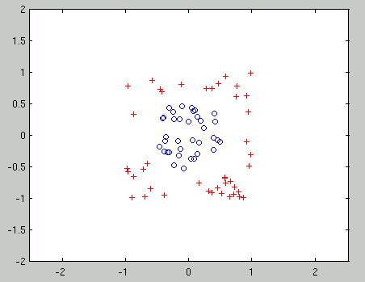
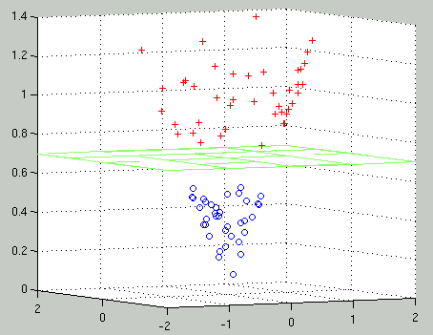
Another Example
Project examples into some higher dimensional space where the data is linearly separable, defined by z = Φ(x)

Slide 45
Algorithm
Pick a Φ function
Map each training example, x, into the new higher-dimensional space using z = Φ(x)
Solve the optimization problem using the nonlinearly transformed training examples, z, to obtain a Linear SVM (with or without using the slack variable formulation) defined by w and b
Classify a new test example, e, by computing: sign(w^{T} · Φ(e) + b)

Slide 46
Improving Efficiency
Time complexity of the original optimization formulation depends on the dimensionality, k, of z (k >> d)
We can convert the optimization problem into an equivalent form, called the Dual Form, with time complexity O(N ³) that depends on N, the number of training examples, not k
Dual Form will also allow us to rewrite the mapping functions in Φ in terms of “kernel functions” instead

Slide 47
Dual Optimization Problem
Maximize
where
subject to these constraints:
Then define:
Then classify with:
f(x,w,b) = sign(w^{T}x - b)
N examples: (x_{k}, y_{k}) where y_{k} = +1 / -1

Slide 48
Dual Optimization Problem
Dot product of two examples
Maximize
where
subject to these constraints:
Then define:
New variables; Examples with α_{k} > 0 will be the support vectors
Then classify with:
f(x,w,b) = sign(w^{T}x - b)
N examples: (x_{k}, y_{k}) where y_{k} = +1 / -1

Slide 49
Dual Optimization Problem (After Mapping)
Maximize
where
Subject to these constraints:
Then define:
Then classify with:
f(x,w,b) = sign(w^{T} Ф(x) - b)
N examples: (x_{k}, y_{k}) where y_{k} = +1 / -1

Slide 50
Dual formulation of the optimization problem depends on the input data only in dot products of the form:
Φ(x_{i})^{T} · Φ(x_{j}) where x_{i} and x_{j} are two examples
We can compute these dot products efficiently for certain types of Φ’s where K(x_{i}, x_{j}) = Φ(x_{i})^{T} · Φ(x_{j})
Example:
Φ(x_{i})^{T} · Φ(x_{j}) = (x_{i}^{T} · x_{j})² = K(x_{i} , x_{j} )
Since the data only appears as dot products, we do not need to map data to higher dimensional space (using Φ(x) ) because we can use the kernel function K instead

Slide 51
Kernel Functions
A kernel function is a function that can be applied to pairs of input data points to evaluate dot products in some corresponding (possibly infinite dimensional) feature space

Slide 52
What’s Special about a Kernel?
Say 1 example is (in 2D) is: s = (s₁, s₂)
We decide to use a particular mapping into 6D space:
Φ(s)^{T} = (s₁², s₂², √2s₁s₂, s₁, s₂, 1)
Let another example be t = (t₁, t₂)
Then,
Φ(s)^{T} • Φ(t) = s₁² t₁² + s₂² t₂² + 2s₁s₂t₁t₂ + s₁t₁ + s₂t₂ + 1
= (s₁t₁ + s₂t₂ + 1)²
= (s^{T}•t +1)²
So, define the kernel function to be K(s, t) = (s^{T}•t +1)²
= Φ(s)^{T} • Φ(t)
We save computation by using K

Slide 53
Some Commonly Used Kernels
Linear kernel: K(x_{i} , x_{j}) = x_{i}^{T} x_{j}
Quadratic kernel: K(x_{i} , x_{j}) = (x_{i}^{T} x_{j} +1)²
Polynomial of degree d kernel: K(x_{i} , x_{j}) = (x_{i}^{T} x_{j} +1)^{d}
Radial Basis Function kernel: K(x_{i} , x_{j}) = exp(−||x_{i} -x_{j} ||² / σ²)
Many possible kernels; picking a good one is tricky
Hacking with SVMs: create various kernels, hope their space Φ is meaningful, plug them into SVM, pick one with good classification accuracy
Kernel usually combined with slack variables because no guarantee of linear separability in new space

Slide 54
Applications of SVMs
Bioinformatics
Machine Vision
Text Categorization
Ranking (e.g., Google searches)
Handwritten Character Recognition
Time series analysis
→ Lots of very successful applications!!!

Slide 55
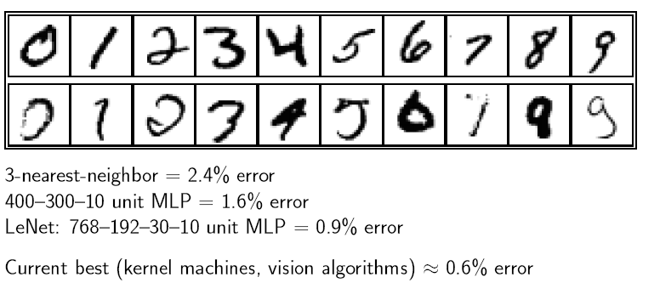
Handwritten Digit Recognition
2012，Deep Learning, 0.23% error !

Slide 56
Example Application: The Federalist Papers Dispute
Written in 1787-1788 by Alexander Hamilton, John Jay, and James Madison to persuade the citizens of New York to ratify(批准) the U.S. Constitution（憲法）
Papers consisted of short essays, 900 to 3500 words in length
Authorship of 12 of those papers have been in dispute ( Madison or Hamilton); these papers are referred to as the disputed Federalist papers

Slide 57
Description of the Data
For every paper:
Machine readable text was created using a scanner
Computed relative frequencies of 70 words that Mosteller-Wallace identified as good candidates for author-attribution studies
Each document is represented as a vector containing the 70 real numbers corresponding to the 70 word frequencies
The dataset consists of 118 papers:
50 Madison papers
56 Hamilton papers
12 disputed papers

Slide 58
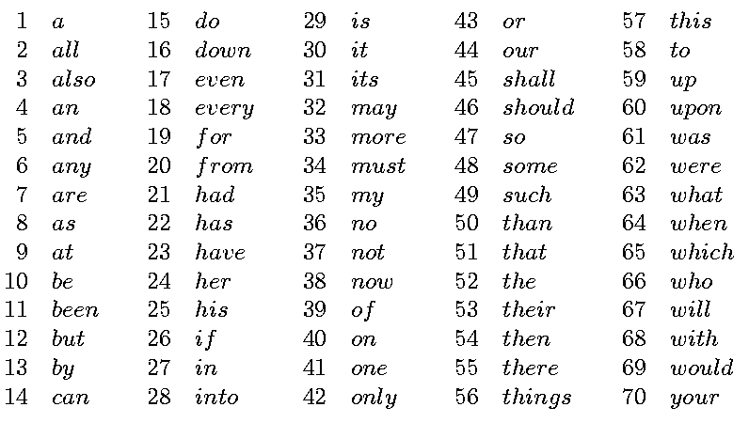
Function Words Based on Relative Frequencies

Slide 59
Feature Selection for Classifying the Disputed Federalist Papers
Apply the SVM Successive Linearization Algorithm for feature selection to:
Train on the 106 Federalist papers with known authors
Find a classification hyperplane that uses as few words as possible
Use the hyperplane to classify the 12 disputed papers

Slide 60
Hyperplane Classifier Using 3 Words
A hyperplane depending on three words was found:
0.537to + 24.663upon + 2.953would = 66.616
All disputed papers ended up on the Madison side of the plane

Slide 61
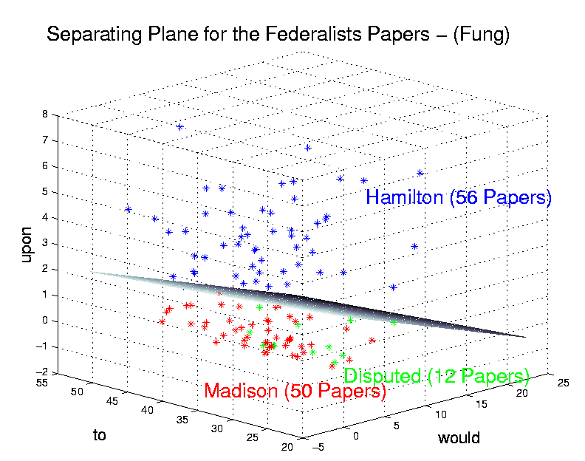
Results: 3D Plot of Hyperplane

Slide 62
Summary
Learning linear functions
Pick separating plane that maximizes margin
Separating plane defined in terms of support vectors only
Learning non-linear functions
Project examples into higher dimensional space
Use kernel functions for efficiency
Generally avoids over-fitting problem
Global optimization method; no local optima
Can be expensive to apply, especially for multi-class problems
Biggest Drawback: The choice of kernel function
There is no “set-in-stone” theory for choosing a kernel function for any given problem
Once a kernel function is chosen, there is only ONE modifiable parameter, the error penalty C

Slide 63
Software
A list of SVM implementations can be found at http://www.kernel-machines.org/software.html
Some implementations (such as LIBSVM) can handle multi-class classification
SVMLight is one of the earliest and most frequently used implementations of SVMs
Several Matlab toolboxes for SVMs are available

